Slide 1

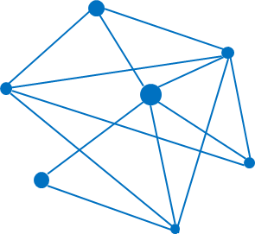
COVID-19 Case Study
Module 3 Group 2 Project
Zexin Du, Fandi Ma, Boyue Wang, Ziyi Wang

Slide 2
EDA Reports
Audience: Public
Overall Report Goal: Explore trend of the spread of coronavirus and compare the growth trends of different countries and regions
Novel Coronavirus Case
Dashboard Design and Implementation

Slide 3
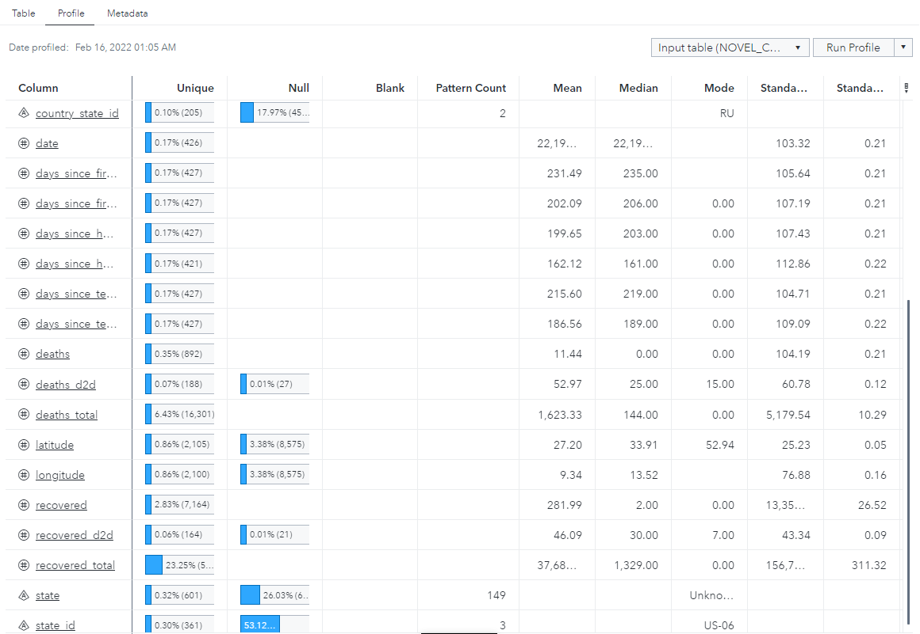
EDA Reports
More than 1 record may be generated in 1 day, so date is not unique identifier
Some records were generated before the number of deaths, recovered to double
Data Understanding
Variable Identification
Some records about location are not accurate to state or province

Slide 4
Categories:
Country
Country(Recorded)
Country ID
Country/State ID
Date
Province/State ID
Province/State Label
Measures(Cases Info):
Confirmed
Confirmed(Days to double)/Country
Confirmed(Total)
Deaths
Deaths(Days to double)/Country
Deaths(Total)
Recovered
Recovered (Days to double)/Country
Recovered(Total)
Number of Days since 1st case/Country
Number of Days since 1st death/Country
Number of Days since 10th case/Country
Number of Days since 10th death/Country
Number of Days since 100th case/Country
Number of Days since 100th death/Country
EDA Reports
Measures(Population Info):
Population ages 0-14
Population ages 14-65
Population ages 65 and above
Population density
Population
Data Understanding
Variable Identification
Measures(Location Info):
Latitude
Longitude

Slide 5
Dashboard Design/Layout

Slide 6
Main Page:
World Map
Key Value of Confirm, Death and Recover
Rank of the Countries
Time series of Confirm, Death and Recover
Country analysis page:
Country population analysis page:
World Map
Population key value
Population distribution
Population rank over the countries
Confirm and Death Ratio for each Countries.
Dashboard Design/Layout

Slide 7
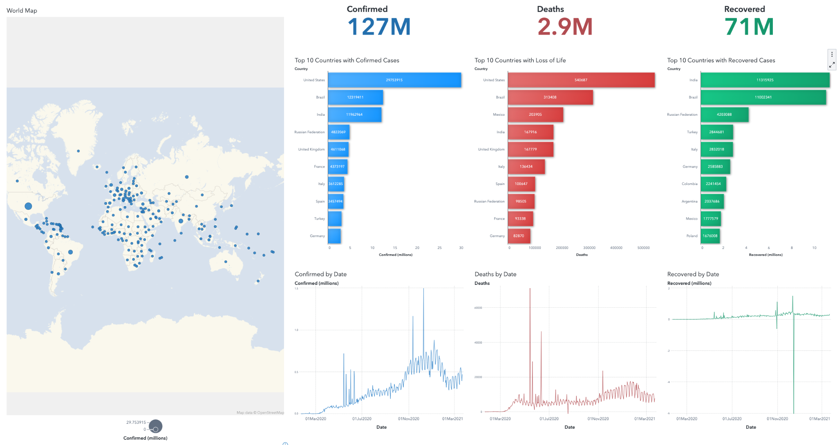

Slide 8
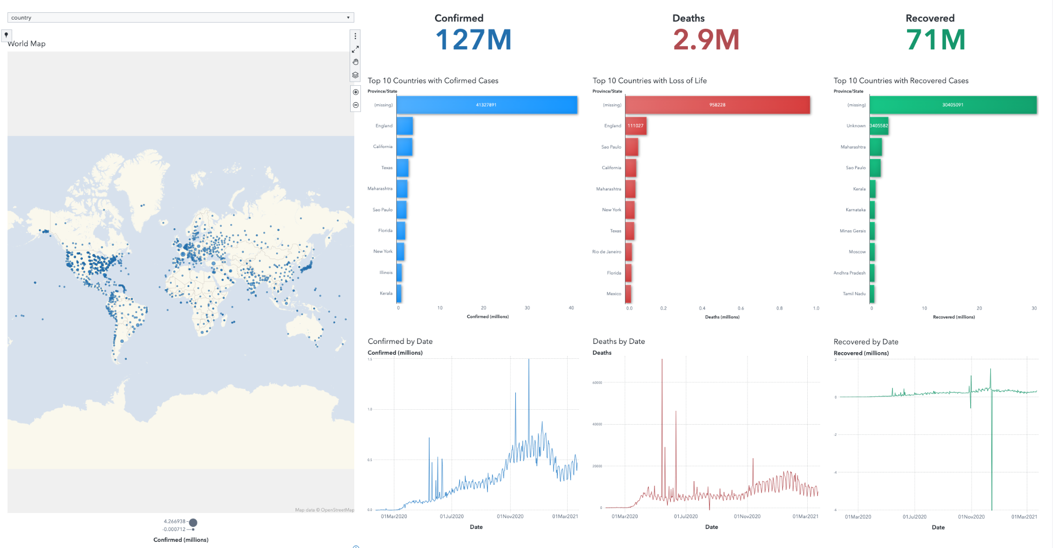

Slide 9
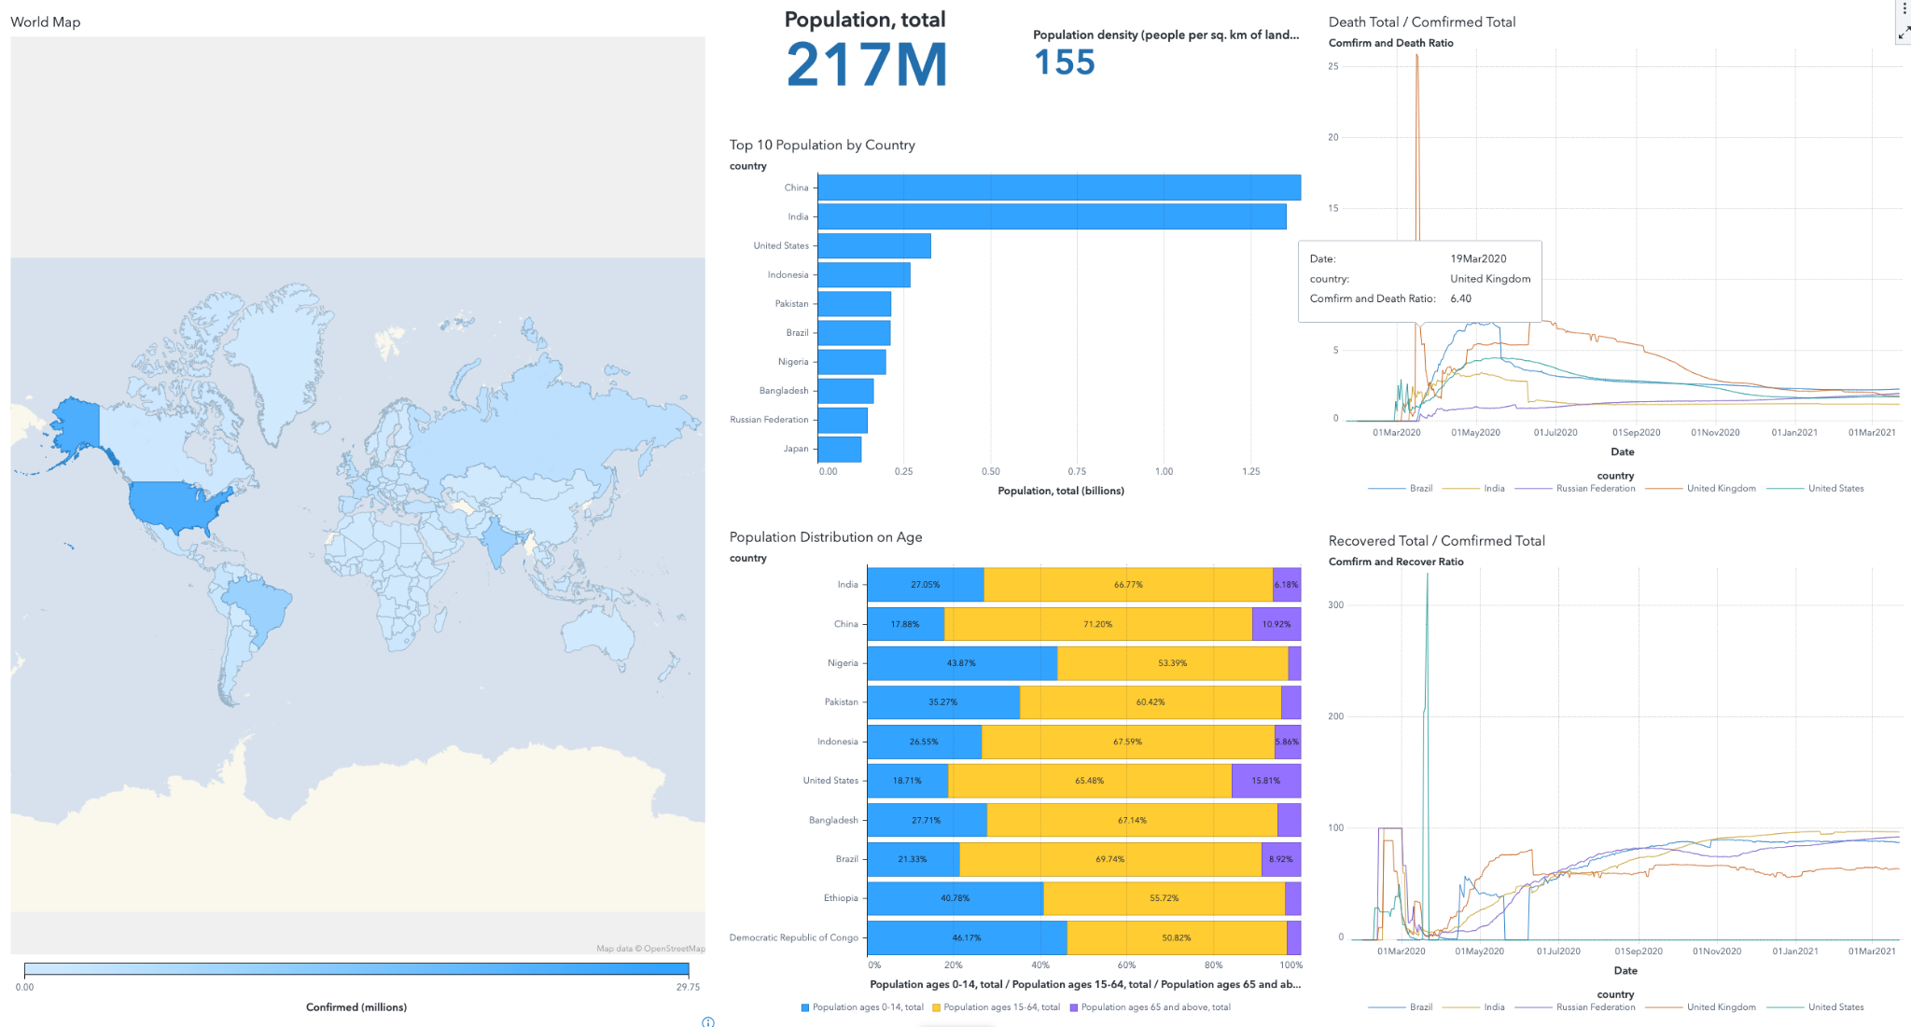

Slide 10
Thank You

